Slide 1

Go, change the world
RV College of
Engineering
Department of Master of Computer Applications
20MCA341 – Artificial Intelligence
market stock price prediction
Under the Guidance
Dr. Shaila H Koppad
Assistant Professor
RV College of Engineering, Bangalore,560059
Rachna A(1RV20MC0)

Slide 2
WHAT WHY & HOW?
WHAT : Stock market prediction is the act of trying to determine the future value of a company stock or other financial instrument traded on an exchange. The successful prediction of a stock's future price could yield significant profit.

Slide 3
Objectives
Collecting the Resources
Creation of web application
Providing the resources to the web application.

Slide 4
Functional Requirements
Module Specification
( Every module has to be described in the following format)
  Module Name
    Input-
    Process-
    Output-

Slide 5
Non Functional Requirements
Describe Non-functional requirements such as performance requirements, safety, security etc

Slide 6
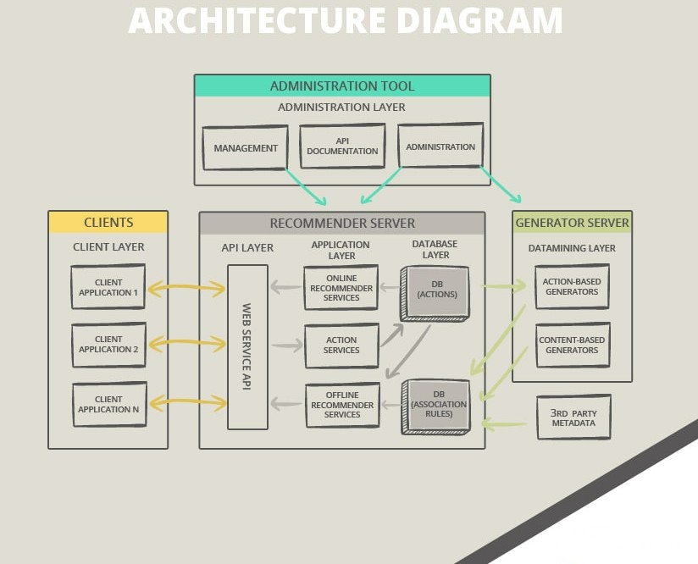
Architectural Design

Slide 7
Data/ Module Definition
Data definition/Dictionary
Module specification / Assumptions made

Slide 8
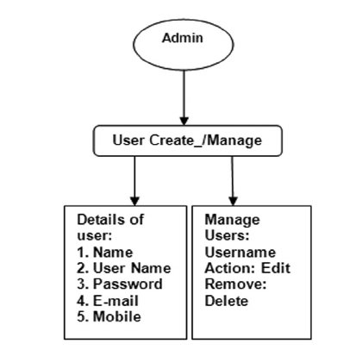
System Design
Object Modeling
Draw Class diagram

Slide 9
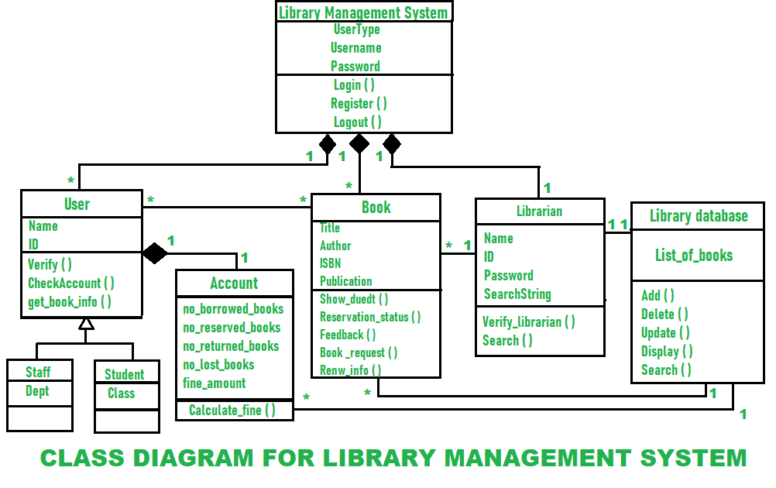
Dynamic modeling
Use case Diagram

Slide 10
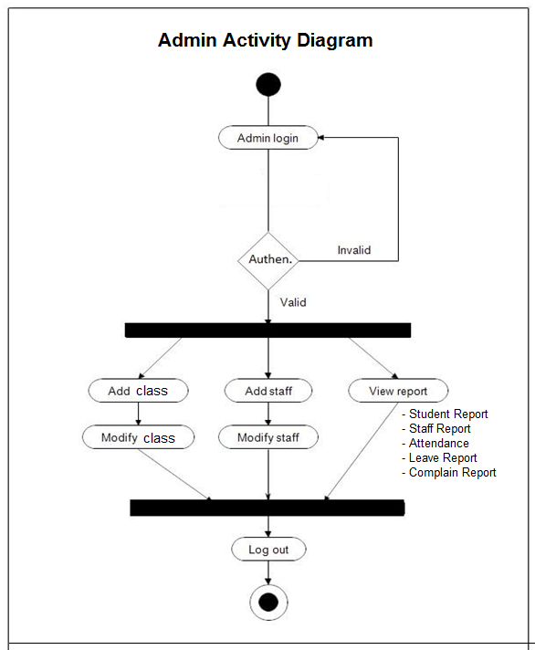
Activity Diagram

Slide 11
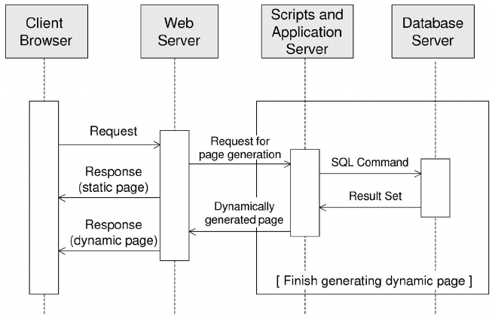
Functional Modeling
Sequence Diagram

Slide 12
Database Design (ER Diagram / Conceptual Schema)

Slide 13
Design Decisions & any assumptions made

Slide 14
Implementation
Implementation ( Discuss Progress of Implementation)

Slide 15
References
List the references used

